Slide 1
Gerli
Leader: SunnerLi
Participation: Han-xun Huang, Hong-lun Jhang, Yu-syuan Hu, Jyun-wei Huang, Yi-shan Jhuang
Date: 2017/1/12

Slide 2
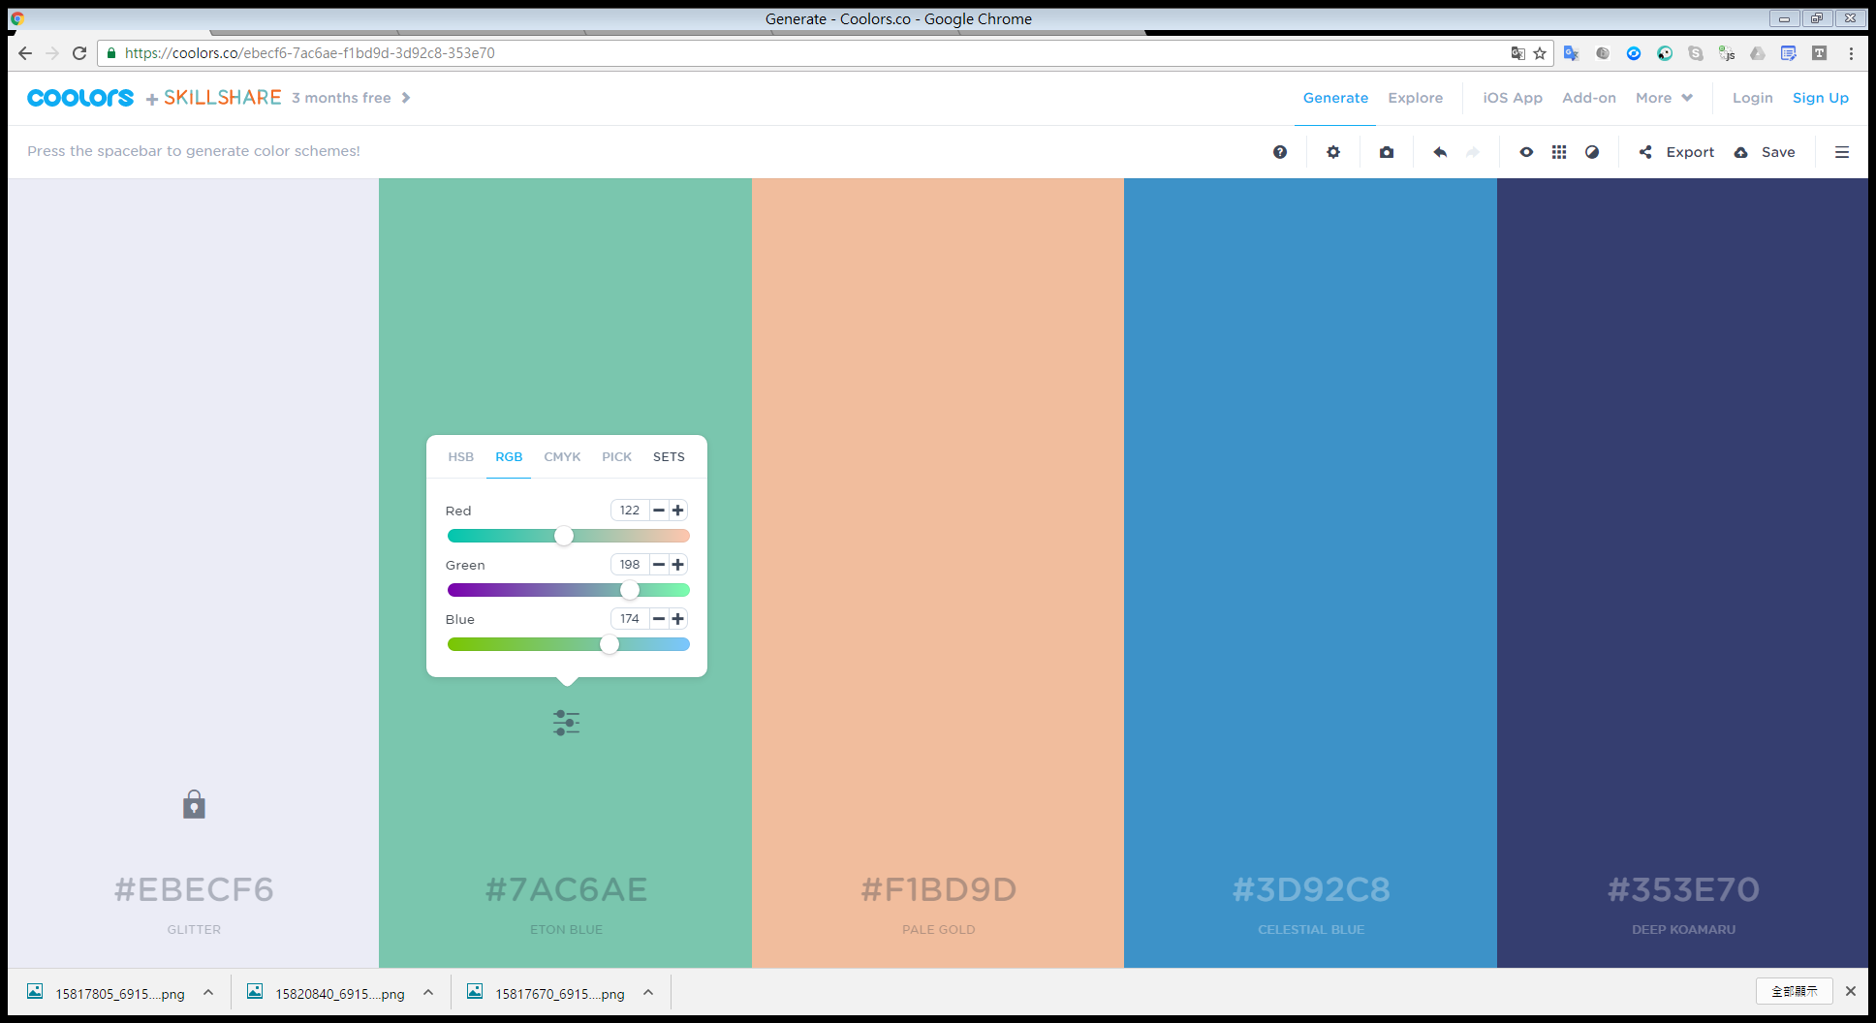
Outline
The goal of the project
The structure of project
The introduction of system
The work division
Experience

Slide 3
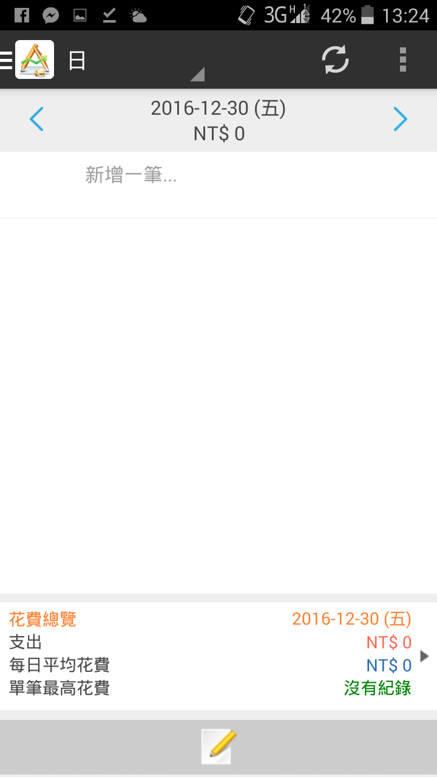


The goal of the project
[ left ]: "AndroMoney", Web.andromoney.com, 2016. [Online]. Available: https://web.andromoney.com/. [Accessed: 23- Nov- 2016].
[ center]: "NaggingMoney 碎碎念記帳", NaggingMoney 碎碎念記帳, 2016. [Online]. Available: http://ajay.myds.me/naggingmoney/. [Accessed: 23- Nov- 2016].
[ right]: "哈啦Money記帳", 哈啦Money記帳, 2016. [Online]. Available: http://halamoney.weebly.com/. [Accessed: 23- Nov- 2016].

Slide 4








The goal of the project
Integrated input methods
Sentiment analysis
Smart accounting
Fixed time remind & FB posting
Cloud copy & chart

Slide 5
The structure of project

Slide 6
The structure of project – cont.

Slide 7

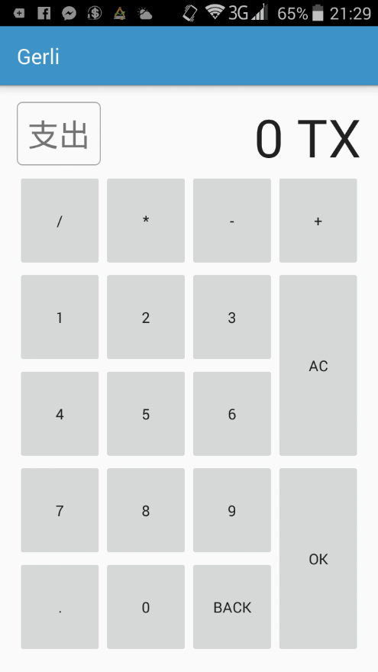
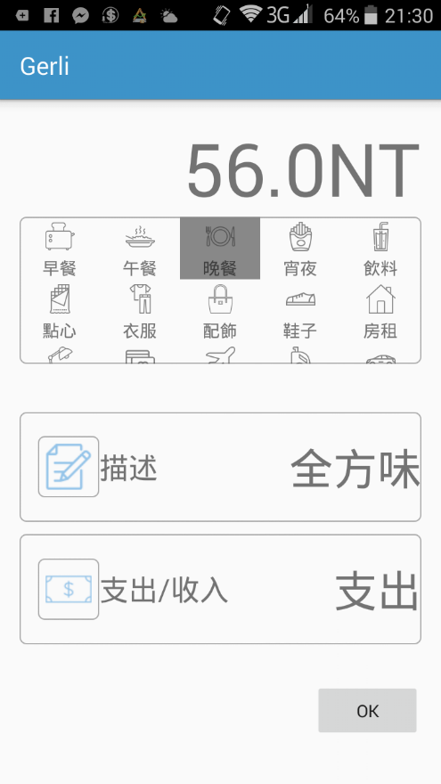


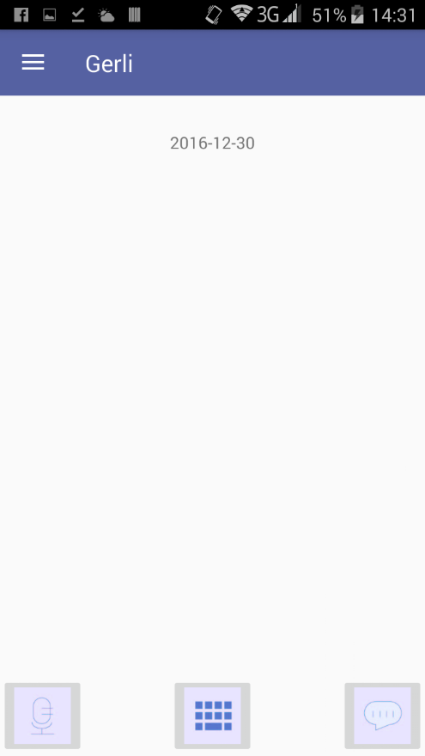
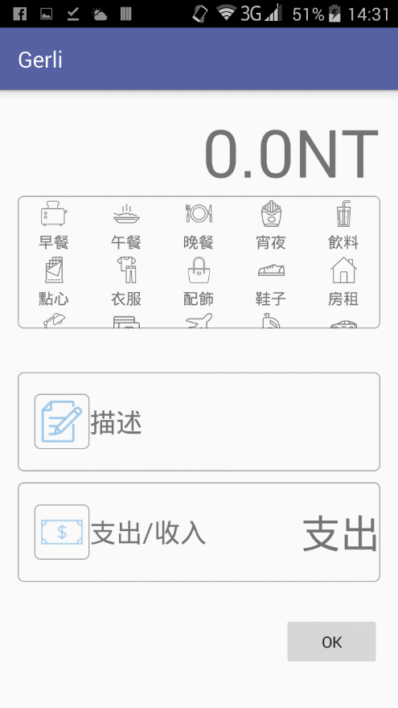
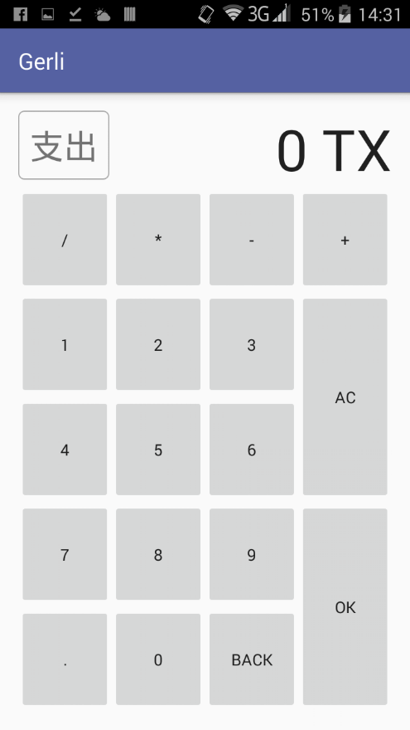

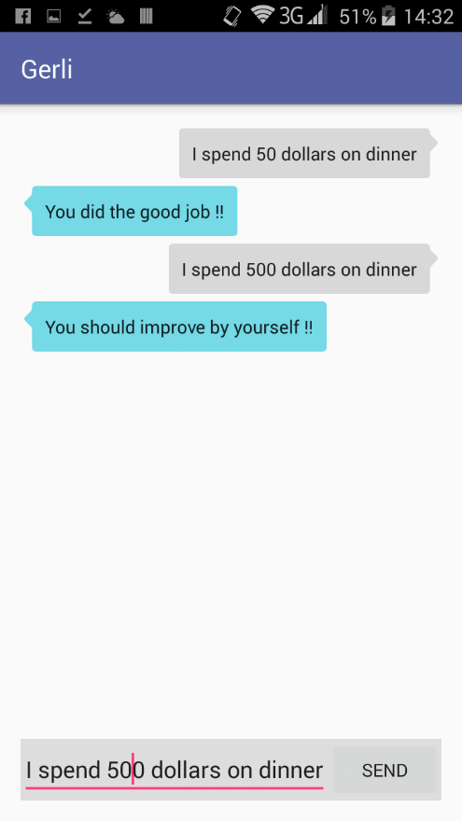
The introduction of system

Slide 8
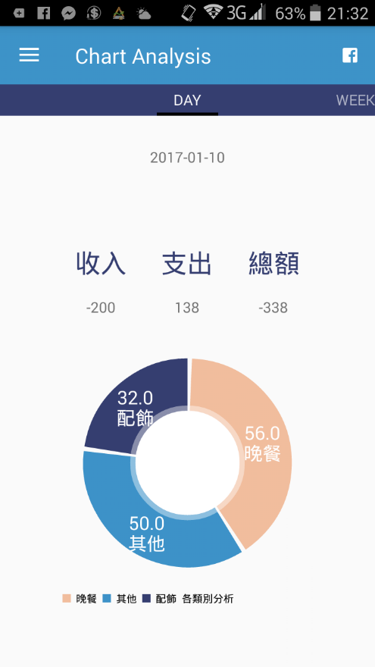
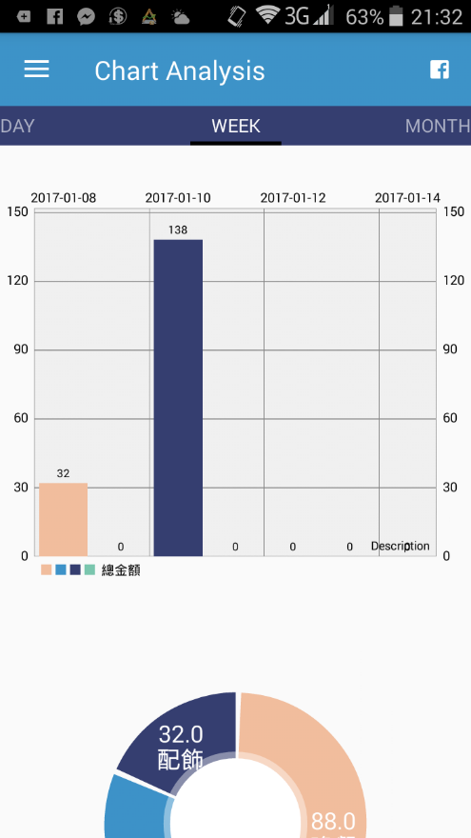
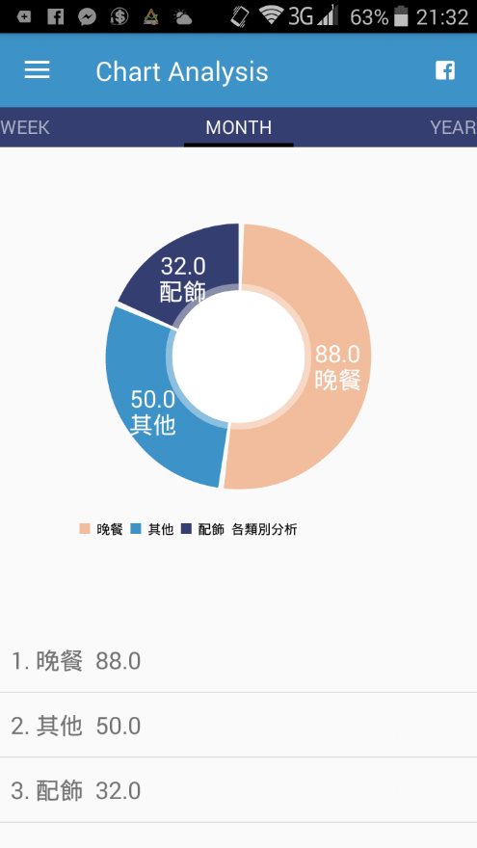
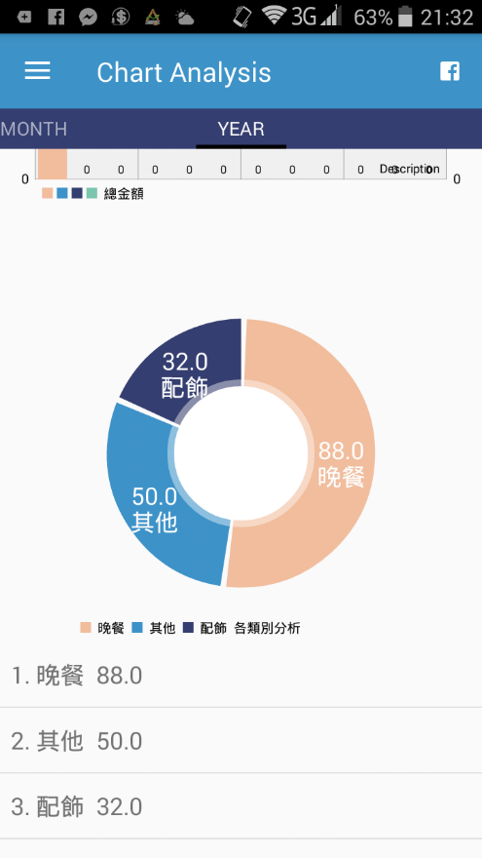

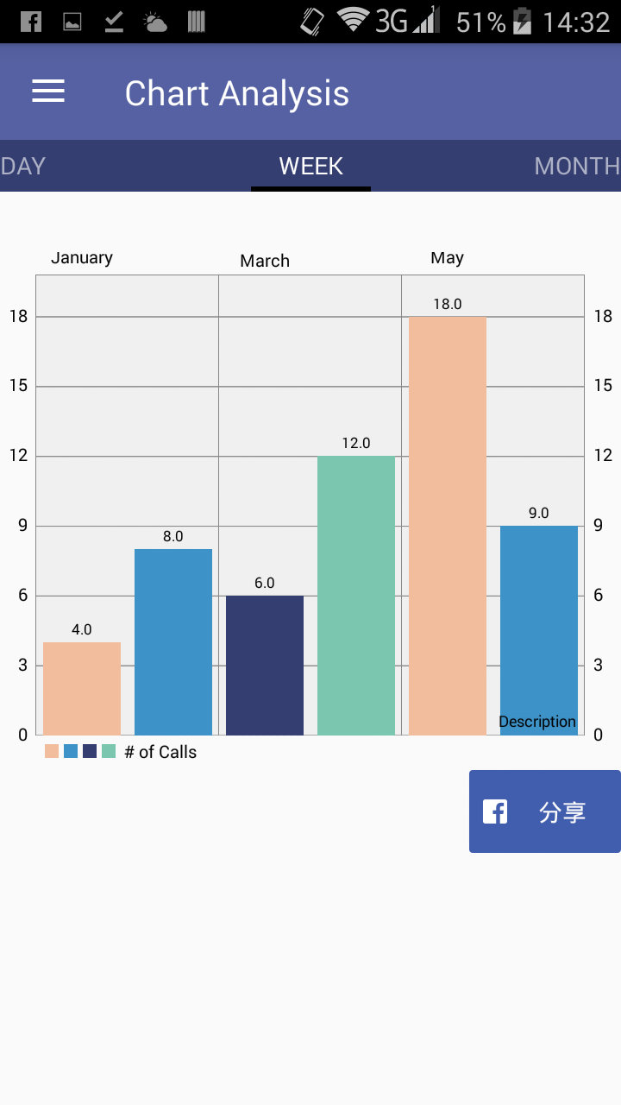
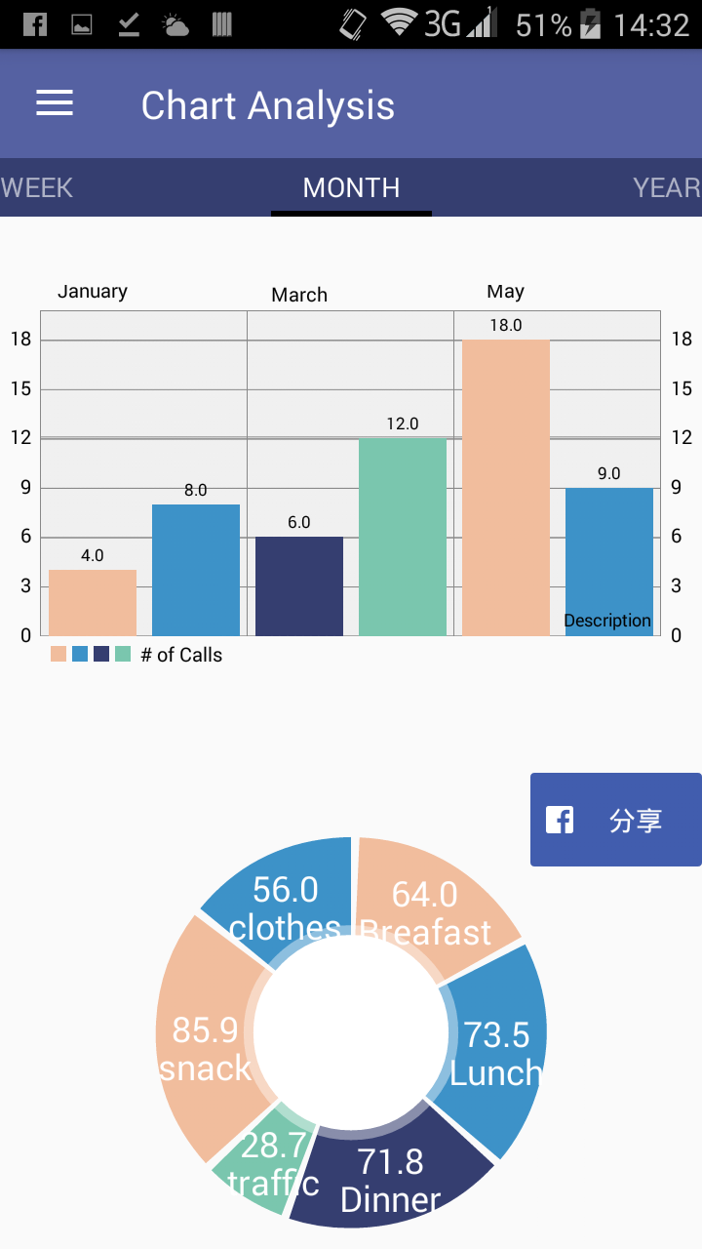
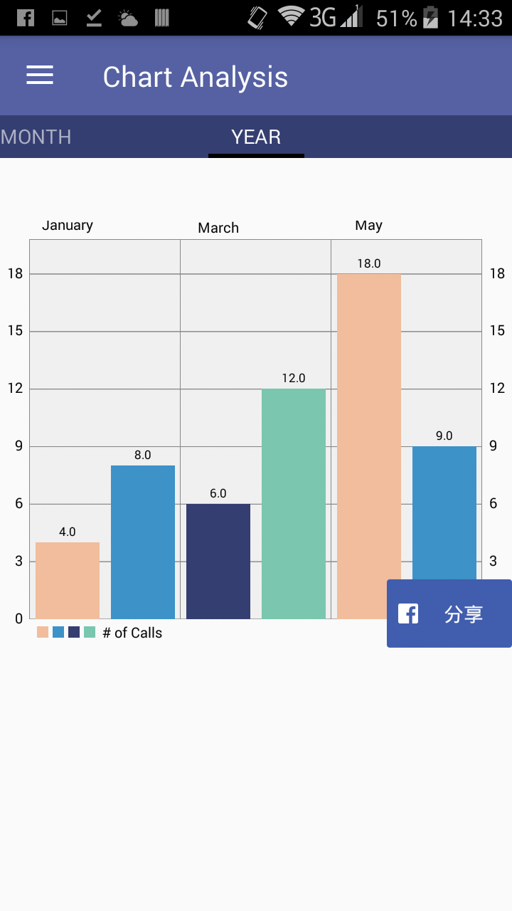
The introduction of system – cont.

Slide 9
The work division
SunnerLi | Han-xun Huang
The whole parser work | Dropbox copy function Timed remind notification
Hong-lun Jhang | Yu-syuan Hu
SQLite management | FB posting function
Jyun-wei Huang | Yi-shan Jhuang
APP structure and layout | Chart showing parts

Slide 10

Experience

Slide 11
Thanks for listening

Slide 12


Slide 16
Reference
[1]"AndroMoney", Web.andromoney.com, 2016. [Online]. Available: https://web.andromoney.com/. [Accessed: 23- Nov- 2016].
[2] "NaggingMoney 碎碎念記帳", NaggingMoney 碎碎念記帳, 2016. [Online]. Available: http://ajay.myds.me/naggingmoney/. [Accessed: 23- Nov- 2016].
[3] "哈啦Money記帳", 哈啦Money記帳, 2016. [Online]. Available: http://halamoney.weebly.com/. [Accessed: 23- Nov- 2016].
[4] T. Mikolov, I. Sutskever, K. Chen, G. Corrado, and J. Dean. “Distributed Representations of Words and Phrases and their Compositionality, ” in Neural Information Process System(NIPS), Lake Tahoe, USA, 5-10 December, 2013.
[5] Pennington, J., Socher, R., and Manning, C. D. “Glove: Global vectors for word representation,” in Empiricial Methods in Natural Language Processing (EMNLP), no. 12, pp. 1532-1543, 2014.
[6] Yoon Kim, “Convolutional Neural Networks for Sentence Classification,” in Conference on Empirical Methods in Natural Language Processing (EMNLP), pp. 1746-1751, Doha , Qatar, 25-29 October, 2014.
[7] Cicero dos Santos, and Maira Gatti, “Deep Convolutional Neural Networks for Sentiment Analysis of Short Texts,” in International Conference on Computational Linguistics (COLING), pp. 69-78, Dublin, Ireland, 23-29 August, 2014.
[8] Aliaksei Severyn, and Alessandro Moschitti, “Twitter Sentiment Analysis with Deep Convolutional Neural Network,” in Special Interest Group on Information Retrieval (SIGIR), Santiago, Chile, 9-13 August, 2015.
[9] Duyu Tang, Bing Qin, and Ting Liu, “Document Modeling with Gated Recurrent Neural Network for Sentiment Classification,” in Conference on Empirical Methods in Natural Language Processing (EMNLP), pp. 1422-1432, Austin, USA, 2-4 November, 2016.
[10] Arkhipenko K. , Kozlov I. , Trofimovich J. , Skorniakov K. , Gomzin A. , Turdakov D., “Comparison of Neural Network Architectures for Sentiment Analysis of Russian Tweets,” in Conference on Computational Linguistics (Dialogue), Moscow, Russia, 1-4 June, 2016

